Slide 1
JavaScript (and jQuery)
Getting started with JavaScript, and specifically jQuery. This assumes working knowledge of HTML and HTML selectors.

Slide 2
Firstly, why JavaScript?
Watch this very short video for an explanation of what it is and what it does:
https://www.youtube.com/watch?v=nItSSTwBvSU
Notes:
Other helpful Links: https://www.youtube.com/watch?v=955L9-NoBoE (older video, but useful explanations)

Slide 3
What is JavaScript? What is jQuery?
JavaScript (JS) is a dynamic, weakly typed, interpreted programming language. It is typically used as a complement to front-end web development, and generally used client-side (as opposed to server-side).
jQuery is a popular JavaScript library which simplifies the syntax, adds additional built-in functionality, and makes the process of developing JS much easier and faster. As of August 2017, jQuery is being used by at least 72.7% of all websites*.
In general, JS programming will not be differentiated from jQuery programming, as it will be assumed that the library is being imported.
*https://w3techs.com/technologies/details/js-jquery/all/all

Slide 4
Including JS and jQuery in a Webpage
To include a standard JavaScript file (i.e. main.js) in an HTML page, the following tag should be added at the bottom of the body tag, right before </body>.
<script src="main.js"></script>c
In order to use jQuery, you must also pull in the jQuery library. To make it easy for prototyping, there are many places online which host the library for you. You can simply include the link to the externally hosted jQuery in your HTML file, such as follows:
<script src="https://code.jquery.com/jquery-3.2.1.min.js"></script>
Important: Assuming you are using jQuery references in your JavaScript file, the order of the links in the HTML file is important: the jQuery link should be first, followed by the JavaScript file links. Typically, the last few lines of an HTML file will look something like:
<script src="https://code.jquery.com/jquery-3.2.1.min.js"></script>
<script src="main.js"></script>
</body>
</html>

Slide 5
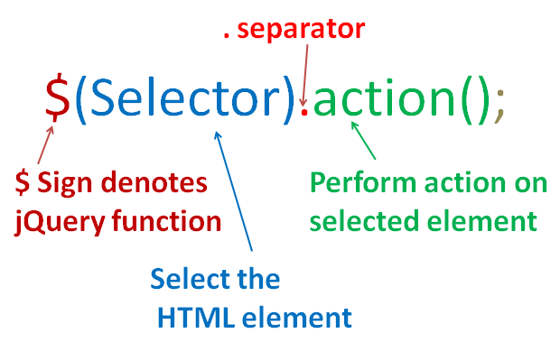
Basic jQuery Syntax

Slide 6
JavaScript Paradigm
While it is possible to use JS as an object-oriented or a functional programming language, as a web technology JS is perhaps best used as an event-driven programming language.
Event-driven Programming is characterized by “events” (such as user actions [button clicks, key-presses], or page events [page loading, server requests]) which triggers code to be run in response to the event.
Web development is almost wholly reliant on event-driven programming. You will want to fire code when a button is clicked, or a form submitted, or text is entered, or the mouse is moved.

Slide 7
An Aside: DOM and DOM-events
The Document Object Model (DOM*) is a programmatic object that represents the HTML document; both the HTML file itself and the page which is rendered.
Effectively, the DOM is what allows you to use a programming language to read the contents of the HTML page, alter what is there, and detect event triggers.
This programmatic representation of the HTML page allows for the propagation (i.e., origination and firing) of “events”, based on the DOM. If someone interacts with a link on the page, a DOM event will be “fired” which indicates that this click has been made. When an element of the DOM loads, a “load” event will be fired.
*https://developer.mozilla.org/en-US/docs/Web/API/Document_Object_Model/Introduction

Slide 8
JavaScript and DOM Events
JavaScript can “listen” for these DOM events, and run code when they are detected. Specifically, in JavaScript you attach an Event Handler to a specific Event Listener, which in turn is attached to a DOM element.
Event Listeners are pieces of JS code which detect when a DOM event is fired. The required methods are built into JS and jQuery; you are simply specifying that you want to know when a particular event occurs on a given element on the page (i.e. when a specific button is clicked).
Event Handlers are functions that are called when an event listener detects an event. This is the code that will be run when, for instance, a user clicks a given button.

Slide 9
Event Listeners and Handlers jQuery
In jQuery, the following code is used to register an event listener, and specify the event handler. You specify the HTML selector to run on, the “on” method, and then the event you are listening for. The second parameter is a function (in this case, an anonymous one) which will run as the event handler.
$("#HTML_SELECTOR").on("DOM_EVENT", function(){
// CODE TO RUN WHEN DOM_EVENT IS TRIGGERED ON
// #HTML_SELECTOR
});
The following are a subset of the DOM events that JavaScript can watch for. A complete list of DOM events is available:
https://developer.mozilla.org/en-US/docs/Web/Events
click
keyup
keydown
keypress
mousenter
mousemove
mouseover
mousedown
mouseup
dblclick
focus
blur
change
submit
scroll

Slide 10
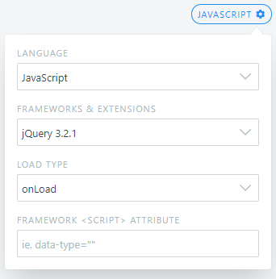
JavaScript Examples
FOLLOW THIS FORMAT
The following code examples range from very basic JavaScript implementations through to highly advanced code. The inline comments expand on what is happening, and relevant HTML markup is provided.
***To work through the following examples, use a tool like https://jsfiddle.net/ , which provides the ability to easily play with HTML and JS in the browser. To include jQuery click on the “JavaScript” button, and in the “Framework & Extensions” selection choose jQuery 3.2.1. (see diagram)

Slide 11
The following examples demonstrate user activated events

Slide 12
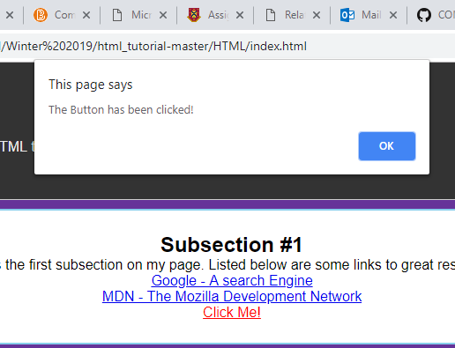
JavaScript:
$( document ).ready(function() {
$("#main_button").on("click", function(){
// When the HTML element with ID 'main_button' is clicked
// this code will run // "Alert" is a JS function which trigger a pop-up window
alert("The Button has been clicked!");
});
});
HTML:
<a href="#" id="main_button">Click Me!</a>

Slide 13
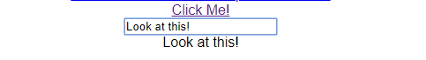
JavaScript:
$("#text_input").on("keyup", function(){
// When the HTML element with ID text_input registers
// the 'keyup' event, this code will run
// $(this) is a special jQuery selector that refers to the HTML
// element that is currently selected. In this case, it refers to
// the #text_input element, since it was the element which triggered
// this code. This line simply takes the value of the #text_input
// and puts it into the #display_text element
$("#display_text").html($(this).val());
});
<input type="text" id="text_input">
<p id="display_text"></p>
HTML:
Result:

Slide 14
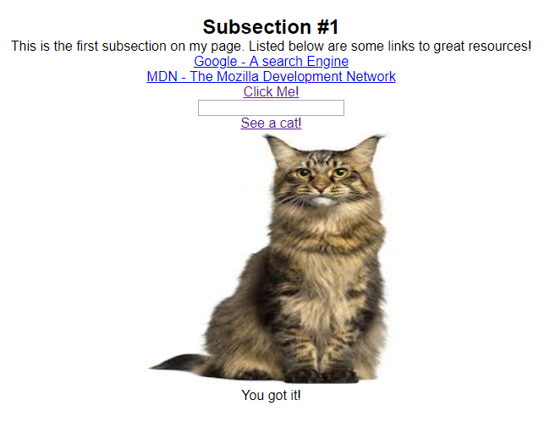
Now, make the following:
When the link is clicked, you will see a cat appear allow with the image of a cat.

Slide 15
JavaScript:
$(".cat").on("click", function(){
alert("Oh so you want cats, eh?");
$('#display_pic').html('<img src = "cat.jpg">');
$('#display_text2').html('<p> You got it! </p>');
}); });
HTML:
<p>
<a href="#" class="cat">See a cat!</a>
</p>
<div id="display_pic">
</div>
<div id="display_text2">
</div>

Slide 16
Advanced JavaScript Examples
The following examples just provide some advanced JS code, which is not tremendously well documented. Try running the code, and discerning what is happening based on the provided examples above.

Slide 17

JavaScript:
// This variable is defined with "Global Scope"
// it can be accessed from within any function in this script
var count = 0;
$("#count_up").on("click", function(){
// When count_up is clicked, add one
count += 1;
// Set the #counter to hold the variable
$("#counter").html(count);
});
$("#count_down").on("click", function(){
// When count_down is clicked, subtract one
count -= 1;
// Set the #counter to hold the variable
$("#counter").html(count);
});
HTML:
<p id="counter">0</p>
<button id="count_up">+1</button>
<button id="count_down">-1</button>
Result:

Slide 18
JavaScript:
// Set Interval is a built-in JS method which calls the given function at a given
// interval; the number is specified in ms
falling_interval = setInterval(function(){
// Count how many '.small_dot's are on the page right now if it is more than 200,
// "clearInterval", which stops the specified interval from running
if ($('.small_dot').length >= 200) {
clearInterval(falling_interval);
return false; // This exits the function
} var new_small_dot = $("<div class='small_dot' />"); // This creates a DOM element
// Choose a random colour, red or blue
var colour = 'blue';
if (Math.random() < 0.5) {
colour = 'red';
}
new_small_dot.css({'position': 'absolute',
'top': Math.floor(Math.random()*$(window).height()),
'left': Math.floor(Math.random()*$(window).width()),
'background': colour,
'height': Math.floor(Math.random()*50)+50,
'width': Math.floor(Math.random()*50)+50
}); $("body").append(new_small_dot); // Add it to the HTML body }, 500); // This will be called every 500ms

Slide 19
JavaScript:
$(".random_mover").on("mouseover", function(){
// Generate a Random Number between 0 and the width of the page
var random_x = Math.floor(Math.random()*$(window).width());
// Generate a Random Number between 0 and the height of the page
var random_y = Math.floor(Math.random()*$(window).height());
// $(this) refers to the .random_mover that was moused over
// change the position on the page to be the random coordinates
$(this).css({'top': random_y+"px", 'left': random_x+"px"});
});
HTML:
<div class="random_mover" style='top: 4px; left: 401px;'></div>
<div class="random_mover" style='top: 100px; left: 230px;'></div>
<div class="random_mover" style='top: 490px; left: 2px;'></div>
<div class="random_mover" style='top: 342px; left: 120px;'></div>
CSS:
.random_mover {
position: absolute;
width: 20px;
height: 20px;
background: tomato;
transition: all 0.5s ease-in-out;
}

Slide 20
$(document).ready(function(){
// Add a box to the page
$drop = $("<div id='drop' />");
$drop.appendTo("body");
// Change the CSS of the Box
$("#drop").css({'background': '#000','width': '50px','height': '50px','border': '5px solid tomato','position': 'absolute','top': '0px','left': '0px','transition': 'all 0.5s ease-in-out'});
$('body').on('keyup', function(key){
var current_pos = $("#drop").offset();
if (key.key === 'ArrowUp') {
current_pos.top -= 50;
if (current_pos.top <= 0) current_pos.top = 0;
$("#drop").css('top', current_pos.top+'px');
} else if (key.key === 'ArrowDown') {
current_pos.top += 50;
if (current_pos.top >= $(window).height() - $("#drop").height() ) current_pos.top = $(window).height() - $("#drop").height();
$("#drop").css('top', current_pos.top+'px');
} else if (key.key === 'ArrowLeft') {
current_pos.left -= 50;
if (current_pos.left <= 0) current_pos.left = 0;
$("#drop").css('left', current_pos.left+'px');
} else if (key.key === 'ArrowRight') {
current_pos.left += 50;
if (current_pos.left >= $(window).width() - $("#drop").width() ) current_pos.left = $(window).width() - $("#drop").width();
$("#drop").css('left', current_pos.left+'px');
}
}); });

Slide 21
$(document).ready(function(){
// When the Document is Ready
// Add a box to the page
$drop = $("<div id='drop' />");
$drop.appendTo("body");
// Change the CSS of the Box
$("#drop").css({'background': '#000','width': '50px','height': '50px','border': '5px solid tomato', 'position': 'absolute','top': '0px','left': '0px'});
var div_location = $("#drop").offset();
var x_dist, y_dist, dist, x_veloc, y_veloc = 0;
// Get Current Mouse Position
$(document).on("mousemove", function(e){
div_location = $("#drop").offset();
x_dist = e.pageX - div_location.left;
y_dist = e.pageY - div_location.top;
dist = Math.sqrt(x_dist**2 + y_dist**2);
x_veloc = 5*x_dist/dist;
y_veloc = 5*y_dist/dist;
});
movementInterval = setInterval(function(){
div_location = $("#drop").offset();
$("#drop").css({
'top': (div_location.top + y_veloc)+"px",
'left': (div_location.left + x_veloc)+"px"
});
}, 1000/40); });

